Slide 1
Regular Expression to NFA
Presented by Yuqing Lin

Slide 2
The Problem:
Construct a finite automata that recognizes the strings described by the regular expression:
(a(aba)*aa)* U bb((ab U baa)* U bbb) aab
Idea to solve the problem: Inside out

Slide 3
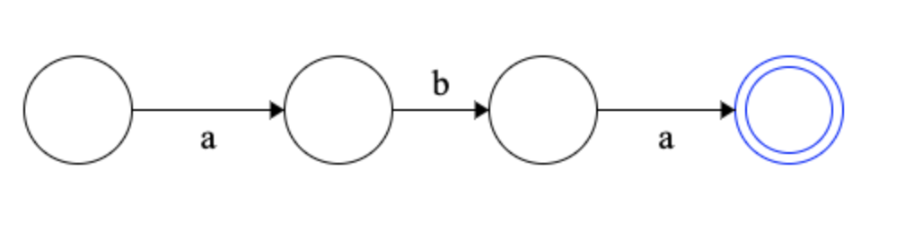
(a(aba)*aa)* U bb((ab U baa)* U bbb) aab aba

Slide 4
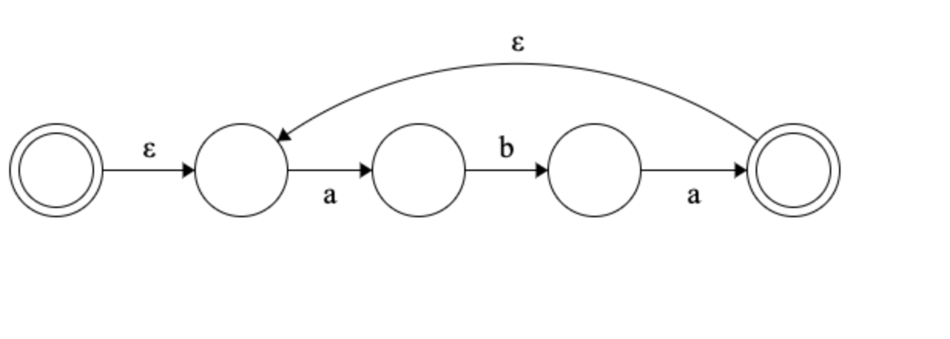
(a(aba)*aa)* U bb((ab U baa)* U bbb) aab (aba)*

Slide 5
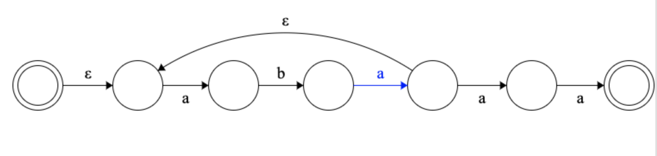
(a(aba)*aa)* U bb((ab U baa)* U bbb) aab (aba)*aa

Slide 6
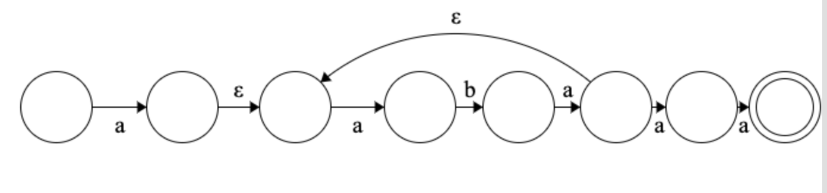
(a(aba)*aa)* U bb((ab U baa)* U bbb) aab a(aba)*aa

Slide 7
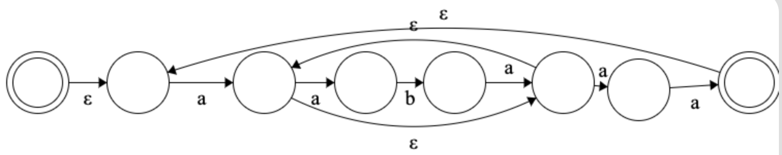
(a(aba)*aa)* U bb((ab U baa)* U bbb) aab (a(aba)*aa)*

Slide 8
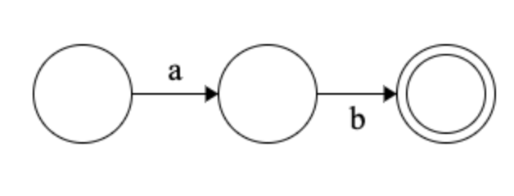
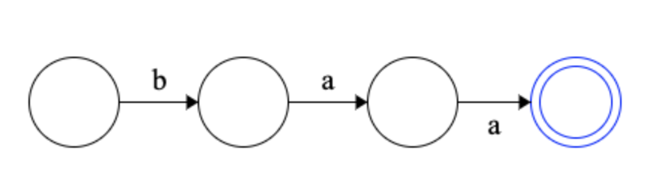
(a(aba)*aa)* U bb((ab U baa)* U bbb) aab ab
bba

Slide 9
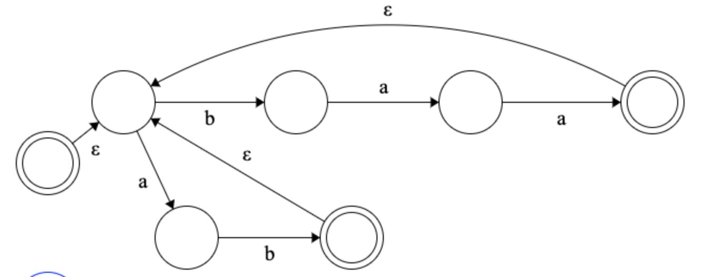
(a(aba)*aa)* U bb((ab U baa)* U bbb) aab (abUbaa)*

Slide 10
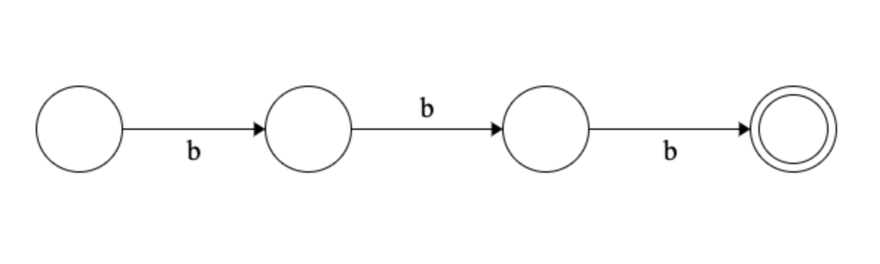
(a(aba)*aa)* U bb((ab U baa)* U bbb) aab bbb

Slide 11
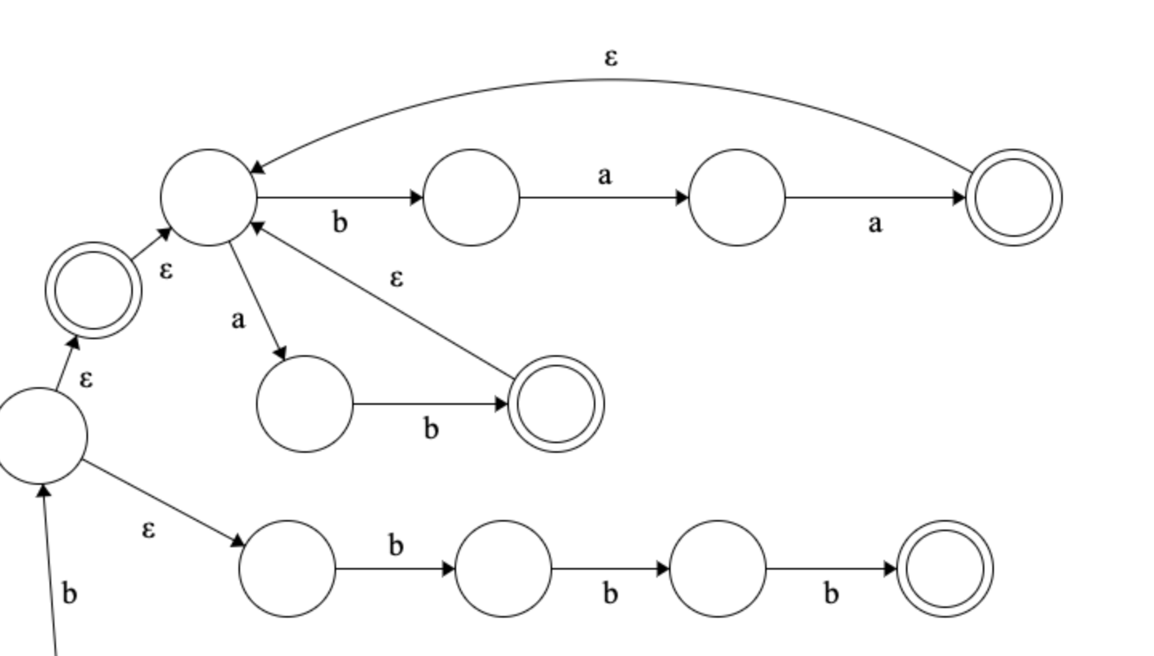
(a(aba)*aa)* U bb((ab U baa)* U bbb) aab (abUbaa)*Ubbb

Slide 12
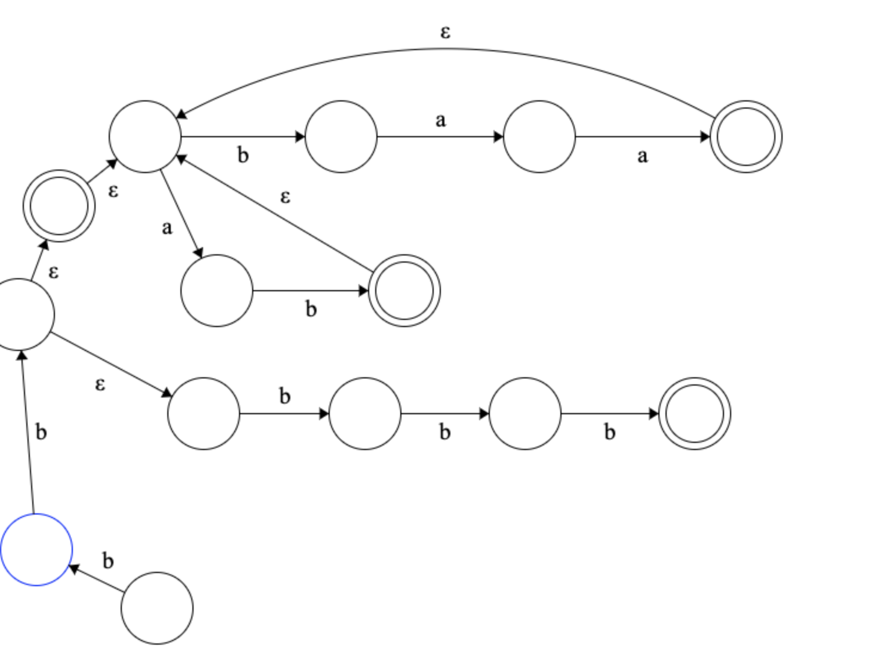
(a(aba)*aa)* U bb((ab U baa)* U bbb) aab (abUbaa)*Ubbb

Slide 13
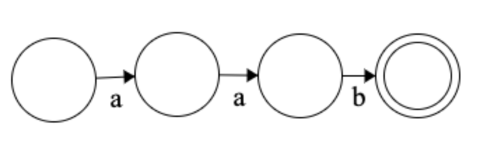
(a(aba)*aa)* U bb((ab U baa)* U bbb) aab aab

Slide 14
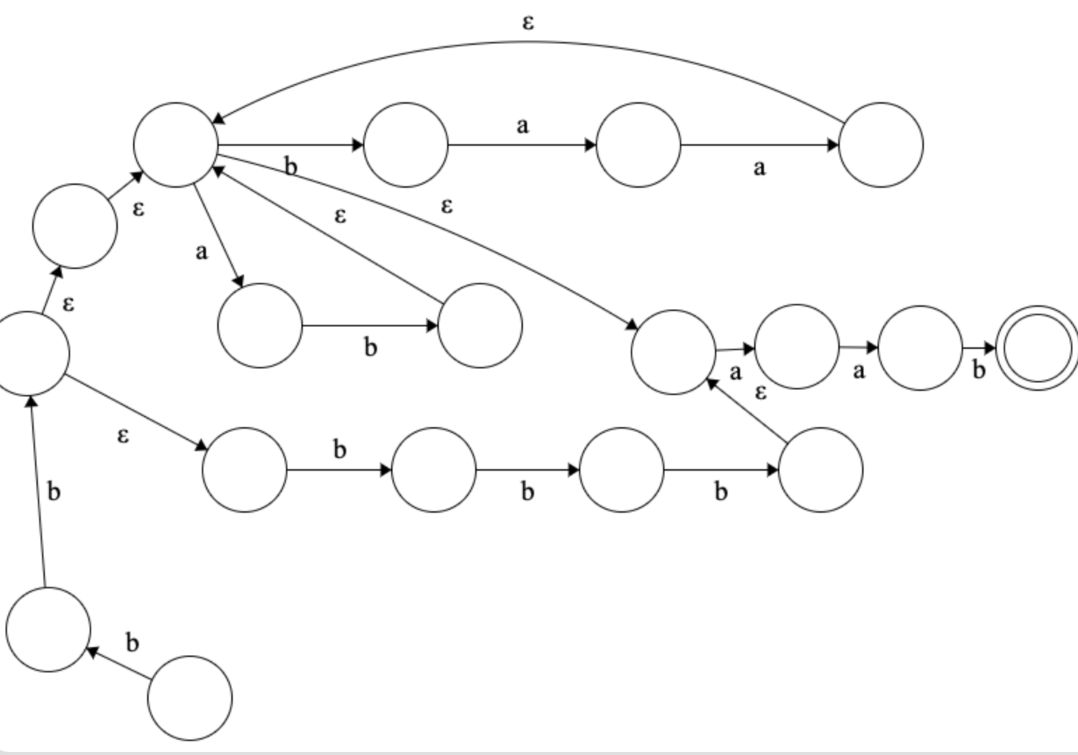
(a(aba)*aa)* U bb((ab U baa)* U bbb) aab bb((abUbaa)*Ubbb)aab

Slide 15
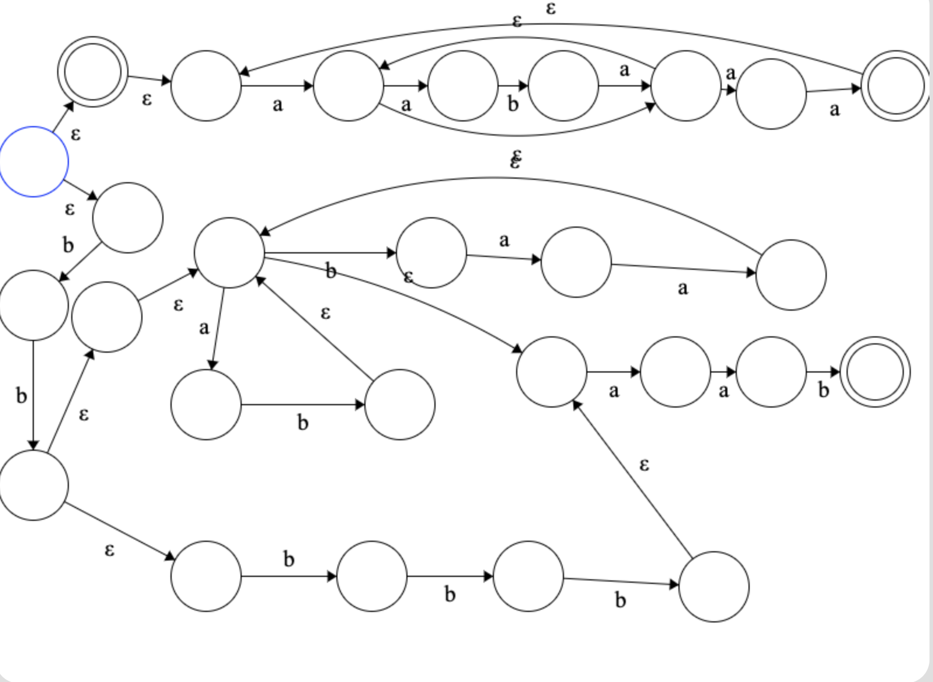
(a(aba)*aa)* U bb((ab U baa)* U bbb) aab

Slide 16
